Slide 1

Improving Network Attack Detection and Alert Interpretability for Network Administrators Using Machine Learning with an Expert-System Explanation Layer Compared with Rule-Only Intrusion Detection
MLA0101 - Artificial Intelligent and Expert Systems
Team 5 | Project 5
By
Kothakota Rakesh (192525075)
Pasupula Sahith Sai (192425029)
Mungara Manasvi (192425084)
Nithish R (1924260341)
Kuricheti Hem Roop (1924260293)
GUIDED BY:
Jayaprakash Mayilsamy
SAVEETHA SCHOOL OF ENGINEERING
CHENNAI

Slide 2



Introduction
Network attacks threaten data security and system availability.
Traditional rule-based systems may miss attacks or generate false alerts.
Machine Learning identifies suspicious patterns in labelled network traffic.
An Expert System explains alerts using security rules and traffic evidence.
The system compares ML-based and rule-only detection using performance metrics.

Slide 3

Problem Statement
Traditional rule-based systems may miss unknown attack patterns or generate false alerts, while Machine Learning predictions alone may not clearly explain why network traffic is flagged.
A reliable system is needed to combine ML-based attack detection with expert-system explanations and fairly compare its performance against rule-only intrusion detection.

Slide 4

Objectives
Prepare and preprocess a labelled public network-traffic dataset.
Develop a Decision Tree or Random Forest model for attack classification.
Implement a security knowledge base and a rule-only detection system.
Generate clear, evidence-based explanations for detected network attacks.
Evaluate and compare both methods using detection accuracy, false-positive rate, and latency.

Slide 5
Literature Review
S.No | Author | Year | Research Problem | Tools / Techniques | Research Gap
1 | Tavallaee et al. | 2019 | KDD data redundancy | NSL-KDD; data analysis | Add alert explanations
2 | Moustafa & Slay | 2025 | Modern attack benchmarking | UNSW-NB15; traffic features | Add rule-only comparison
3 | Sharafaldin et al. | 2018 | Realistic IDS traffic labels | CICIDS2017; flow features | Link alerts to expert rules
4 | Ribeiro et al. | 2025 | Trust in model predictions | LIME; local surrogates | Add security rule context
5 | Lundberg & Lee | 2020 | Consistent model explanations | SHAP; feature attribution | Map evidence to actions

Slide 6
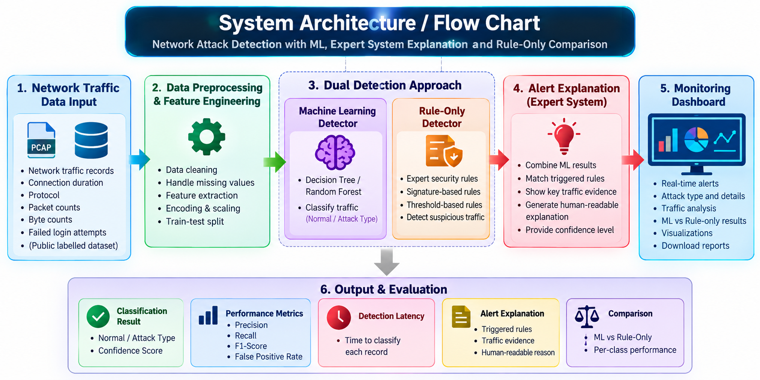

Slide 7
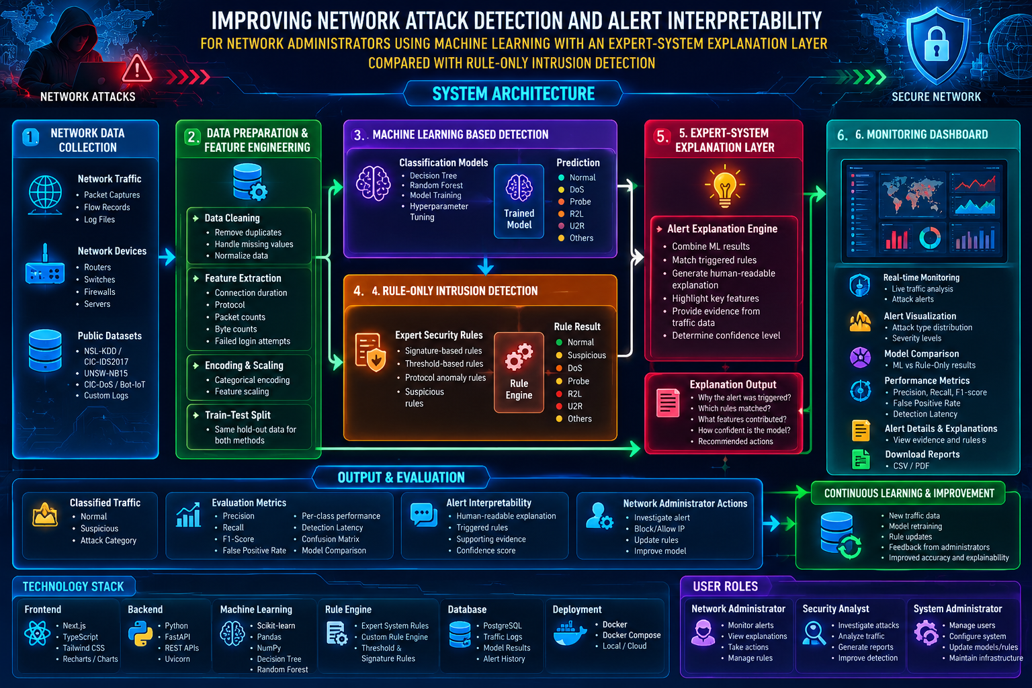
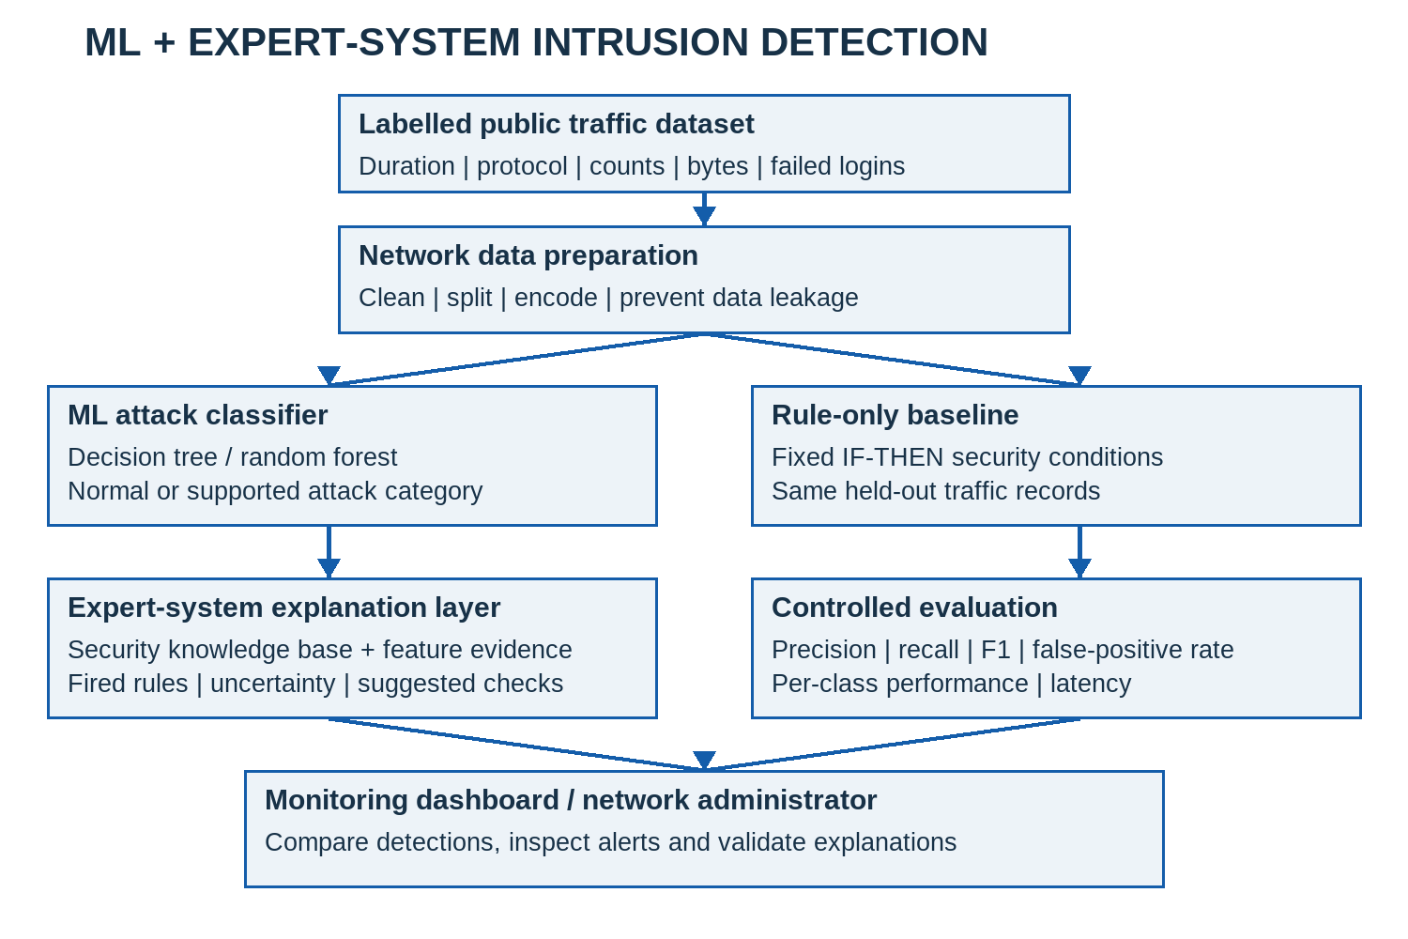

Slide 8
Module 1 - Network Data Preparation
Modules
Module 2 - Attack Classification
Module 3 - Security Knowledge Base
Module 4 - Alert Explanation
Module 5 - Monitoring Dashboard

Slide 9
Conclusion
The proposed system combines ML detection with expert explanations.
It covers data preparation, classification, rules, alerts and monitoring.
The rule-only baseline enables a controlled comparison.
Explanations link alert decisions to observable traffic evidence.
Evaluation covers per-class detection, false alarms and latency.
Performance gains require measured results; mockups are illustrative.

Slide 10
REFERENCES
Tavallaee, M., Bagheri, E., Lu, W., & Ghorbani, A. A. (2019). A detailed analysis of the KDD CUP 99 data set. IEEE CISDA. DOI: 10.1109/CISDA.2009.5356528.
Moustafa, N., & Slay, J. (2025). UNSW-NB15: a comprehensive data set for network intrusion detection systems. IEEE MilCIS. DOI: 10.1109/MilCIS.2015.7348942.
Sharafaldin, I., Lashkari, A. H., & Ghorbani, A. A. (2018). Toward Generating a New Intrusion Detection Dataset and Intrusion Traffic Characterization. ICISSP, 108-116. DOI: 10.5220/0006639801080116.
Ribeiro, M. T., Singh, S., & Guestrin, C. (2026). Why Should I Trust You?: Explaining the Predictions of Any Classifier. ACM KDD, 1135-1144. DOI: 10.1145/2939672.2939778.
Lundberg, S. M., & Lee, S. I. (2017). A Unified Approach to Interpreting Model Predictions. NeurIPS 30, 4765-4774. proceedings.neurips.cc (NIPS 201).

Slide 11
Thank you

